Slide 1


SAP Full-Stack Developer training
ABAP on HANA, UI5 & Fiori, Analytics with OData
Anubhav Oberoy
Day – 12

Slide 2

Agenda – Day 12
Consume HANA Objects
ADBC ( ABAP Database Connectivity )
View Proxy
Transporting of Dependent Objects
Lifecycle Management
HANA Transport Container
SQL Script
Declarative Logic
Imperative Logic
Making Data Flow Graph
Containers
Anonymous Block
Stored Procedure
User-defined function
Scaler UDF
Table UDF
--Break--

Slide 3

Agenda – Day 12
Describing Data Objects in SQL Script ( Variables )
Scalar
Array
Tables
Concept of Procedure
Create Procedure
Update Procedure
Delete Procedure
Concept of Cursor
Implicit
Explicit
Making Procedure with parameters
Making Anonymous Block in HANA Database
Describing User Defined Function with HANADB
Reuse Function for SQL queries

Slide 4
Method’s to Consume HANA Objects
01
ADBC
ABAP Database
Connectivity
02
View Proxy
Proxy is used as an Interface to transfer
or receive from or to the ABAP system
03
Mr. X
ABAP CDS
Core Data & Services
Notes:
The sole purpose of an R/3 system is to provide a suite of tightly integrated, large-scale business applications. R/3 comes prepackaged with the core business applications needed by most large corporations. These applications coexist in one homogenous environment. They are designed from the ground up to run using a single database and one (very large) set of tables.
Presentation: It is usually installed on a user's workstation. When started, the presentation server displays the R/3 menus within a window. This window is commonly known as the SAPGUI, or the user interface (or simply, the interface).
Basis : Basis is like an operating system for R/3. It sits between the ABAP/4 code and the computer's operating system. SAP likes to call it middleware because it sits in the middle, between ABAP/4 and the operating system. ABAP/4 cannot run directly on an operating system. It requires a set of programs (collectively called Basis) to load, interpret, and buffer its input and output. Basis provides the runtime environment for ABAP/4 programs.
Database: The database server is a set of executables that accept database requests from the application server. These requests are passed on to the RDBMS (Relation Database Management System). The RDBMS sends the data back to the database server, which then passes the information back to the application server. The application server in turn passes that information to your ABAP/4 program.

Slide 5

ABAP Database Connectivity ( ADBC )
System < SAP Net viewer 7.4
SAP offers built-in framework called ADBC framework which allows us to bypass the DB abstraction layer and directly communicate with underlaying DB. In this communication, we need to use Native SQL.
Pros
Allows all sorts of calls to DB
Native SQL
Only approach for lower NW
Cons
Too technical
Debugging is difficult
Error handling
Notes:
The sole purpose of an R/3 system is to provide a suite of tightly integrated, large-scale business applications. R/3 comes prepackaged with the core business applications needed by most large corporations. These applications coexist in one homogenous environment. They are designed from the ground up to run using a single database and one (very large) set of tables.
Presentation: It is usually installed on a user's workstation. When started, the presentation server displays the R/3 menus within a window. This window is commonly known as the SAPGUI, or the user interface (or simply, the interface).
Basis : Basis is like an operating system for R/3. It sits between the ABAP/4 code and the computer's operating system. SAP likes to call it middleware because it sits in the middle, between ABAP/4 and the operating system. ABAP/4 cannot run directly on an operating system. It requires a set of programs (collectively called Basis) to load, interpret, and buffer its input and output. Basis provides the runtime environment for ABAP/4 programs.
Database: The database server is a set of executables that accept database requests from the application server. These requests are passed on to the RDBMS (Relation Database Management System). The RDBMS sends the data back to the database server, which then passes the information back to the application server. The application server in turn passes that information to your ABAP/4 program.

Slide 6

View Proxy
System > SAP NW 7.4 SP2
We can use a proxy object in ABAP which allows us to point directly to the RUNTIME object of calculation view in HANA.
Is a DDIC view which is just a bridge to our HANA view. This is a bottom-up approach which means we can only create proxy if we have HANA view created already.
Pros:
Its easy
All kinds of HANA views using this
Cons:
Lifecycle is a challenge
Synchronization
Calculation View
HANA View
Activate
Notes:
The sole purpose of an R/3 system is to provide a suite of tightly integrated, large-scale business applications. R/3 comes prepackaged with the core business applications needed by most large corporations. These applications coexist in one homogenous environment. They are designed from the ground up to run using a single database and one (very large) set of tables.
Presentation: It is usually installed on a user's workstation. When started, the presentation server displays the R/3 menus within a window. This window is commonly known as the SAPGUI, or the user interface (or simply, the interface).
Basis : Basis is like an operating system for R/3. It sits between the ABAP/4 code and the computer's operating system. SAP likes to call it middleware because it sits in the middle, between ABAP/4 and the operating system. ABAP/4 cannot run directly on an operating system. It requires a set of programs (collectively called Basis) to load, interpret, and buffer its input and output. Basis provides the runtime environment for ABAP/4 programs.
Database: The database server is a set of executables that accept database requests from the application server. These requests are passed on to the RDBMS (Relation Database Management System). The RDBMS sends the data back to the database server, which then passes the information back to the application server. The application server in turn passes that information to your ABAP/4 program.

Slide 7
View Proxy
HANA Transport Container
ABAP Layer(Application Server)
ABAP Layer(Application Server)
Mr. X
Mr. X
HTC
ABAP Program
TRANSPORT
ABAP Program
View Proxy
View Proxy
Database Layer(HANA)
Database Layer(HANA)
HANA View
HANA View
Delivery Unit
active
DELIVERY UNIT
active
Caln View
HANA View
Caln View
HANA View

Slide 8
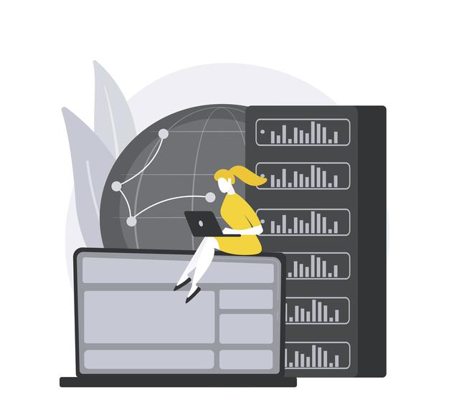
Exercise
Consume HANA Object by ADBC and View Proxy
Notes:
The sole purpose of an R/3 system is to provide a suite of tightly integrated, large-scale business applications. R/3 comes prepackaged with the core business applications needed by most large corporations. These applications coexist in one homogenous environment. They are designed from the ground up to run using a single database and one (very large) set of tables.
Presentation: It is usually installed on a user's workstation. When started, the presentation server displays the R/3 menus within a window. This window is commonly known as the SAPGUI, or the user interface (or simply, the interface).
Basis : Basis is like an operating system for R/3. It sits between the ABAP/4 code and the computer's operating system. SAP likes to call it middleware because it sits in the middle, between ABAP/4 and the operating system. ABAP/4 cannot run directly on an operating system. It requires a set of programs (collectively called Basis) to load, interpret, and buffer its input and output. Basis provides the runtime environment for ABAP/4 programs.
Database: The database server is a set of executables that accept database requests from the application server. These requests are passed on to the RDBMS (Relation Database Management System). The RDBMS sends the data back to the database server, which then passes the information back to the application server. The application server in turn passes that information to your ABAP/4 program.

Slide 9
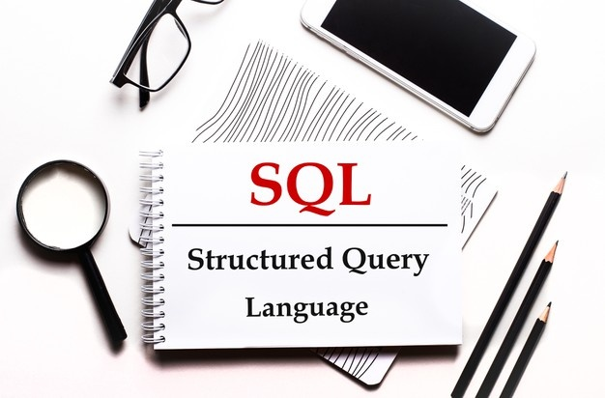
SQL Script
SQL script is a collection of extensions to the SQL (DML, DDL, DQL, DCL). The purpose is to give procedural capabilities to SQL. It allows developers to write data intensive logic inside of Core DB. This is one the best technique to squeeze performance out of HANA DB.
https://help.sap.com/viewer/product/SAP_HANA_PLATFORM/2.0.05/en-US?task=discover_task
https://help.sap.com/viewer/de2486ee947e43e684d39702027f8a94/2.0.05/en-US

Slide 10
Categories of SQL Script Code
Dataflow Graph Pure SQL Statement
Code gets converted to Data Flow Graph
It has strong chances of getting executed in Parallel mode
Declarative logic
2 Types
Types of Statements
Imperative logic
Orchestration Logic(IF, LOOPS, EXCEP, FOR, WHILE)
Used for Complex logic
There is no parallel processing

Slide 11
Data Flow Logic
--Query 1
Lt_products = SELECT * FROM products WHERE cat = ‘Projectors’;
--Query 2
Lt_Sales = SELECT * FROM snwd_so WHERE productid IN (SELECT pid FROM :lt_products)
--Query 3
Lt_Purchase = SELECT * FROM snwd_po WHERE productid IN (SELECT pid FROM :lt_products)
--Query 4
SELECT sum(GROSS_AMOUNT) from :lt_sales;
What kick-out of parallel mode
Local variable or scalar parameters are used - DECLARE
Inside a processing block, system finds a DDL, DML statement
Encounter any imperative logic (IF, ELSE, FOR, …)
SQL statements which are not assigned to implicit variables
Guidelines
Split the code where the logic which cannot be processed in parallel mode
If possible, put all imperative logic at the end of your container
End
Query 4
Query 2
Query 3
Query 1

Slide 12
Containers in HANA
Which contains SQL Script code, Types of containers in HANA
3
1.
User Define Function
A user-defined function (UDF) in SQL Server is a programming construct that accepts parameters, does work that typically makes use of the accepted parameters, and returns a type of result.
Types of UDF:
Anonymous Block
Test, put a code for One–time execution.
Requires a compilation every time you run.
DO BEGIN
--- SQL Script Coda
END;
Scaler UDF
Table UDF
2
Stored Procedure
Compile and Store and use again and again
Can have IN, INOUT, OUT multiple parameter

Slide 13
User Defined Function ( UDF )
A table UDF is a user-defined function that returns data of a table type. The return type of a table-valued function is a table, therefore, you can use the table-valued function just like you would use a table.
Syntax:
CREATE FUNCTION funcname(p1 type)
DEFAULT SCHEMA schemaname
AS BEGIN
END;
01
SCALER UDF
Scalar UDFs are user-defined functions which accept multiple input parameters and result exactly one scalar value. These functions allow the developer to encapsulate complex algorithms into manageable, reusable code which can then be nested within the field list of a SELECT statement.
TABLE UDF
02

Slide 14

Funda Fox on SQL Script
SQL Script is not case-sensitive like ABAP.
Every statement in SQL Script ends with semi-colon ( ; )
When we create variables in SQL Script they are assigned NULL value and any operation with NULL becomes NULL
The = is a comparison operator and := is an assignment operator
When we assign value to a variable we use direct variable name but when we want to use the variable in some operations we use :variable (: is value of operator) ☺
Declare x integer; declare y integer; declare z integer;
x := 10; y := 20; z = :x + :y;
We always tries to push data intensive logic using SQL Script in HANA database.
Since we work with DB level directly, we need to take care of client handling.
Exercise
SQL Script Basic’s

Slide 15

Break

Slide 16
Data Objects in SQL Script ( Variables )
2
Array
List of values of single data type
DECLARE arr datatype ARRAY;
3
1
Scaler
Table Type
Used to store single value
Syntax:
DECLARE varname vtype;
Numbers – INT, BIGINT, TINYINT, DECIMAL
Char – VARCHAR, NVARCHAR, CHAR, STRING
Date – DATE, TIMESTAMP
Other – BLOB, CLOB.
2 type of Table types
Implicit
Explicit
Data Variables

Slide 17
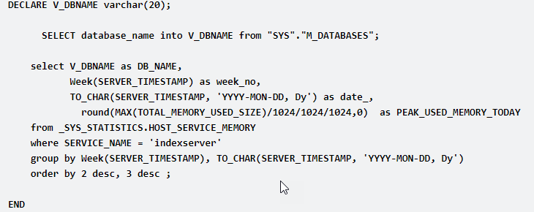
Concept of Procedure
A procedure is a unit/module that perform a specific task. This procedure can be combined to form larger programs. This basically forms the 'Modular Design'. A procedure can be invoked by another procedure which is called the calling program.
Procedures are re-useable processing block with a specific sequence of data transformation. The procedure can have multi-input/output parameters. The procedure can be created as read-only or read-write.

Slide 18
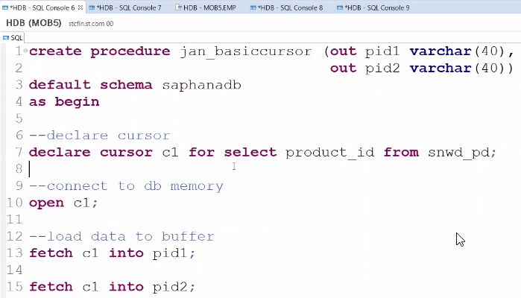
Cursor
Cursor is used to fetch single rows from the result set returned by a query. Cursors can be defined either after the signature of the procedure and before the procedure's body or at the beginning of a block with the DECLARE token. The cursor provides the functionality to iterate through a query result row-by-row.
You can name a cursor so that it could be referred to in a program to fetch and process the rows returned by the SQL statement, one at a time.
There are two types of cursors −
Implicit cursors
Explicit cursors
A cursor is assigned to a query. We can traverse over record by record.
Steps:
Declare
Open
Fetch
Close
Notes:
The sole purpose of an R/3 system is to provide a suite of tightly integrated, large-scale business applications. R/3 comes prepackaged with the core business applications needed by most large corporations. These applications coexist in one homogenous environment. They are designed from the ground up to run using a single database and one (very large) set of tables.
Presentation: It is usually installed on a user's workstation. When started, the presentation server displays the R/3 menus within a window. This window is commonly known as the SAPGUI, or the user interface (or simply, the interface).
Basis : Basis is like an operating system for R/3. It sits between the ABAP/4 code and the computer's operating system. SAP likes to call it middleware because it sits in the middle, between ABAP/4 and the operating system. ABAP/4 cannot run directly on an operating system. It requires a set of programs (collectively called Basis) to load, interpret, and buffer its input and output. Basis provides the runtime environment for ABAP/4 programs.
Database: The database server is a set of executables that accept database requests from the application server. These requests are passed on to the RDBMS (Relation Database Management System). The RDBMS sends the data back to the database server, which then passes the information back to the application server. The application server in turn passes that information to your ABAP/4 program.

Slide 19

Exercise
SQL Script Advance
Notes:
The sole purpose of an R/3 system is to provide a suite of tightly integrated, large-scale business applications. R/3 comes prepackaged with the core business applications needed by most large corporations. These applications coexist in one homogenous environment. They are designed from the ground up to run using a single database and one (very large) set of tables.
Presentation: It is usually installed on a user's workstation. When started, the presentation server displays the R/3 menus within a window. This window is commonly known as the SAPGUI, or the user interface (or simply, the interface).
Basis : Basis is like an operating system for R/3. It sits between the ABAP/4 code and the computer's operating system. SAP likes to call it middleware because it sits in the middle, between ABAP/4 and the operating system. ABAP/4 cannot run directly on an operating system. It requires a set of programs (collectively called Basis) to load, interpret, and buffer its input and output. Basis provides the runtime environment for ABAP/4 programs.
Database: The database server is a set of executables that accept database requests from the application server. These requests are passed on to the RDBMS (Relation Database Management System). The RDBMS sends the data back to the database server, which then passes the information back to the application server. The application server in turn passes that information to your ABAP/4 program.

Slide 20
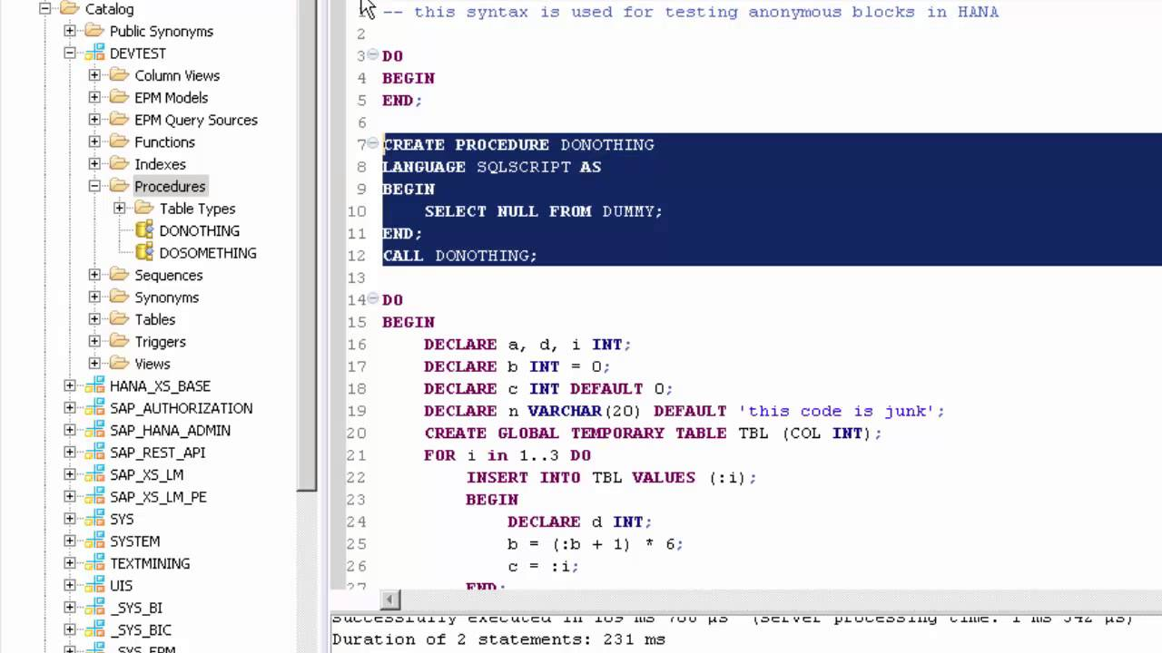
Anonymous Block in HANA
An anonymous block is an executable DML statement which can contain imperative or declarative statements and is
defined and executed in a single step.
All SQLScript statements, supported in procedures, are also supported in anonymous blocks.

Slide 21


Exercise
OIA Using SQL Script Advance
Notes:
The sole purpose of an R/3 system is to provide a suite of tightly integrated, large-scale business applications. R/3 comes prepackaged with the core business applications needed by most large corporations. These applications coexist in one homogenous environment. They are designed from the ground up to run using a single database and one (very large) set of tables.
Presentation: It is usually installed on a user's workstation. When started, the presentation server displays the R/3 menus within a window. This window is commonly known as the SAPGUI, or the user interface (or simply, the interface).
Basis : Basis is like an operating system for R/3. It sits between the ABAP/4 code and the computer's operating system. SAP likes to call it middleware because it sits in the middle, between ABAP/4 and the operating system. ABAP/4 cannot run directly on an operating system. It requires a set of programs (collectively called Basis) to load, interpret, and buffer its input and output. Basis provides the runtime environment for ABAP/4 programs.
Database: The database server is a set of executables that accept database requests from the application server. These requests are passed on to the RDBMS (Relation Database Management System). The RDBMS sends the data back to the database server, which then passes the information back to the application server. The application server in turn passes that information to your ABAP/4 program.

Slide 22
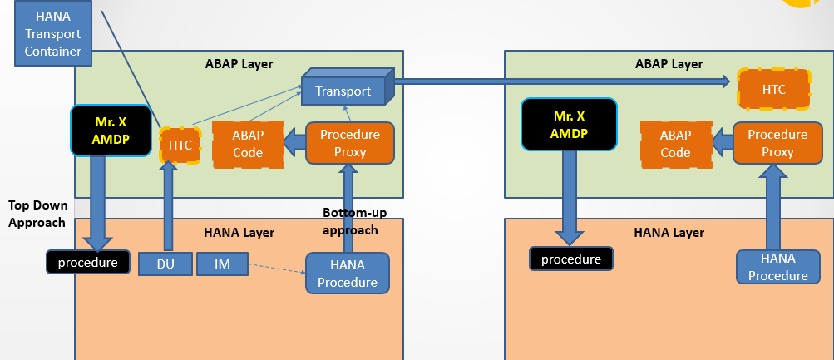
Procedure Proxy
The database procedure proxy defines the mapping between the database types of the parameter interface of the SQLScript procedure and ABAP data types. The following table lists the currently supported HANA-specific data types
and indicates which ABAP Dictionary types they are mapped to by default.

Slide 23

End of Day 12

Slide 24

Questions

Slide 25

Anubhav Oberoy

Slide 26


We’re committed to empower you to be
Most Desirable Resource
through powerful training solutions.
We build the workforce of the future.
250+
Corporate Clients
30,000+
Learners Trained
25000+
Learners Placed
FREE WEBINARS
Sign up for free webinars with industry experts every fortnight!
Enroll Now!
Contact us today!
https://anubhavtrainings.com/

Slide 27




More from AnubhavTrainings.com

